Slide 1



Mentorness
Hotel Reservation Analysis
with SQL
2023 - 2024
TAZi Mohannad

Slide 2
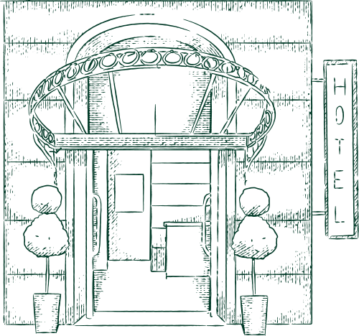

Project 01
Vue d'ensemble
01 | Overview
02 | Dataset Details
03 | Analysis
04 | Insights
TAZI Mohannad
02

Slide 3
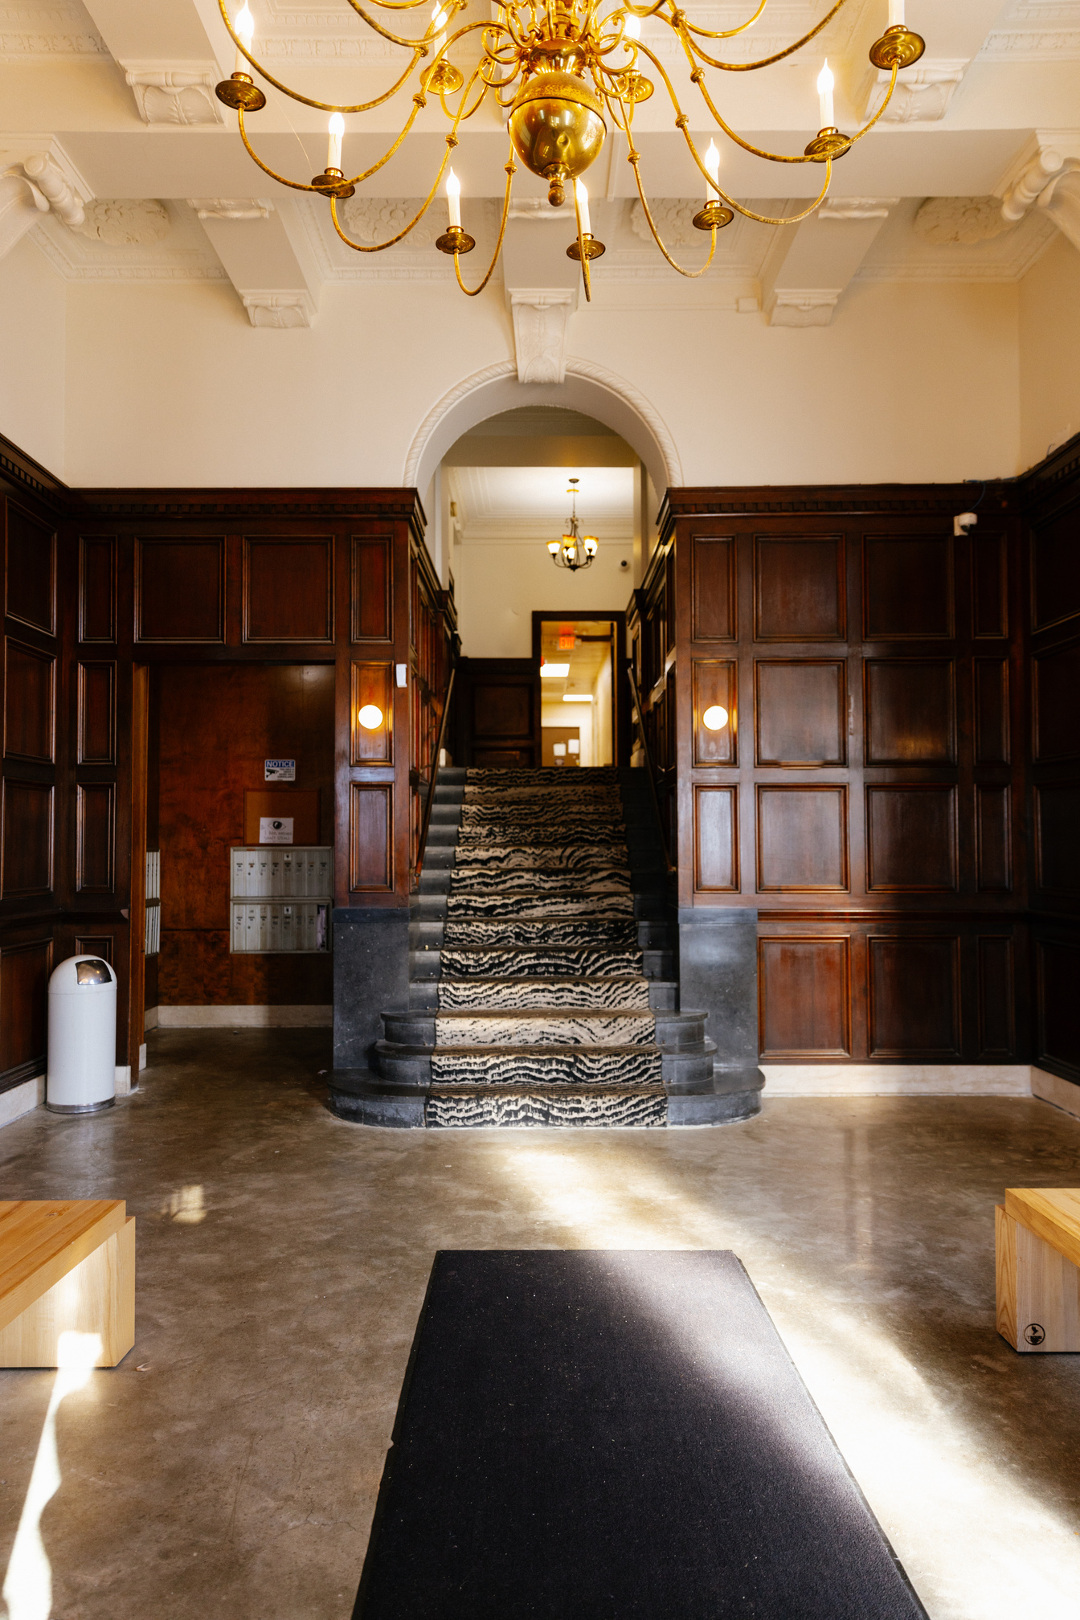
Project 01
Overview
The hotel industry relies on data to make informed decisions and provide a better guest experience.
In this internship, I will work with a hotel reservation dataset to gain insights into guest preferences, booking trends, and other key factors that impact the hotel's operations.
I will use SQL to query and analyze the data, as well as answer specific questions about the dataset.
TAZI Mohannad
03

Slide 4


Project 01
Dataset Details
Booking_ID: A unique identifier for each hotel reservation.
no_of_adults: The number of adults in the reservation.
no_of_children: The number of children in the reservation.
no_of_weekend_nights: The number of nights in the reservation that fall on weekends.
no_of_week_nights: The number of nights in the reservation that fall on weekdays.
type_of_meal_plan: The meal plan chosen by the guests.
room_type_reserved: The type of room reserved by the guests.
lead_time: The number of days between booking and arrival.
arrival_date: The date of arrival.
market_segment_type: The market segment to which the reservation belongs.
avg_price_per_room: The average price per room in the reservation.
booking_status: The status of the booking.
TAZI Mohannad
04

Slide 5


Project 01
Hotel Reservation Analysis
with SQL
TAZI Mohannad
05

Slide 6
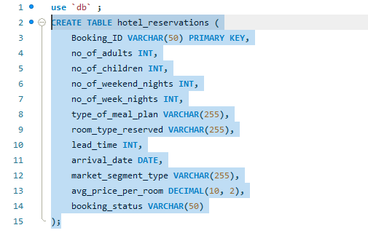
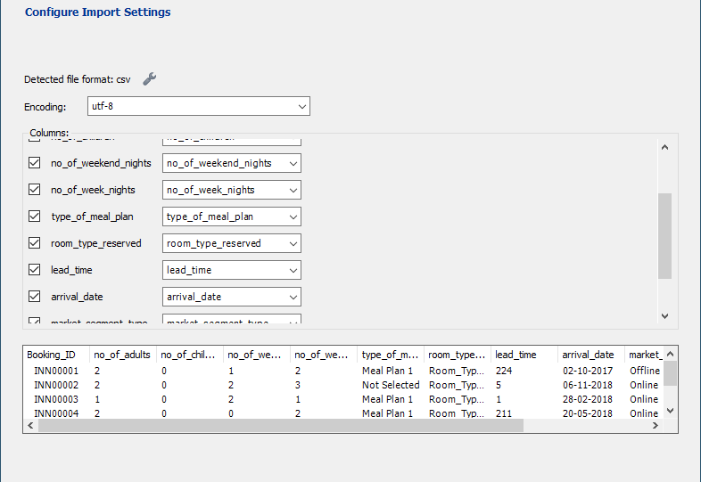
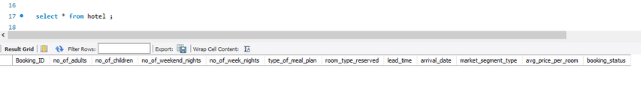
Project 01
pre analysis
CREATE TABLE
IMPORT CSV FILE
TAZI Mohannad
06

Slide 7
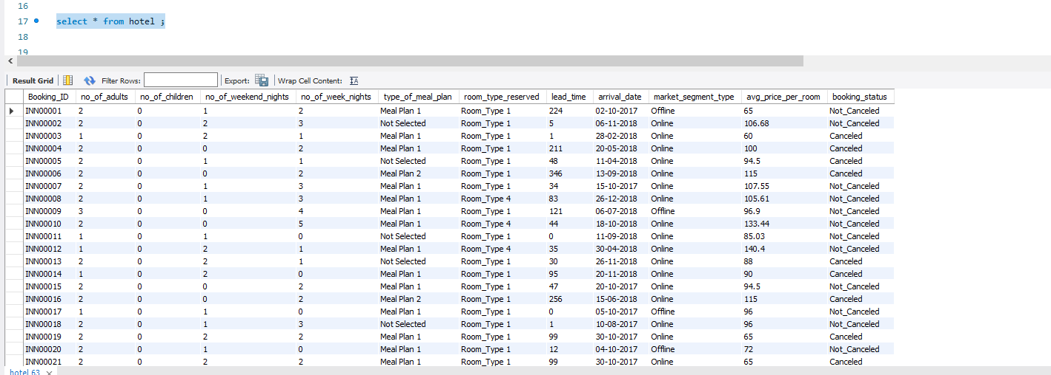
Project 01
Hotel Reservation Dataset
TAZI Mohannad
07

Slide 8
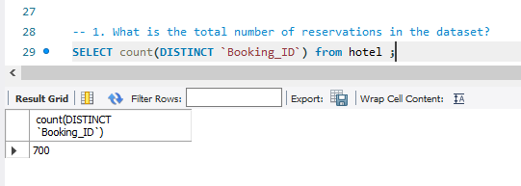
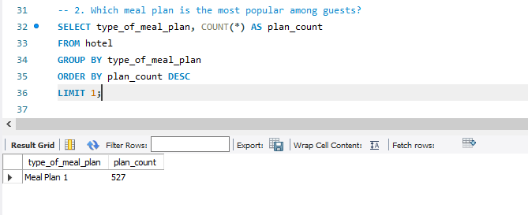
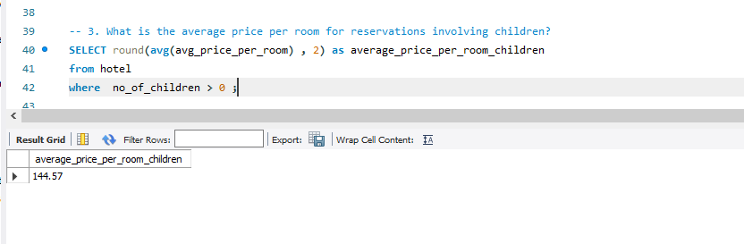
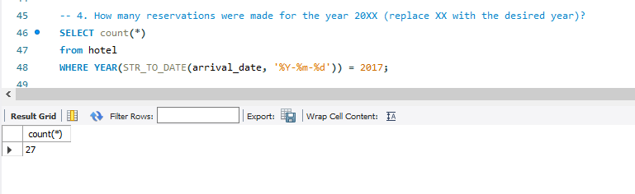
Project 01
63 %
63 %
63 %
63 %
63 %
Retour à l'ordre du jour
TAZI Mohannad
08

Slide 9
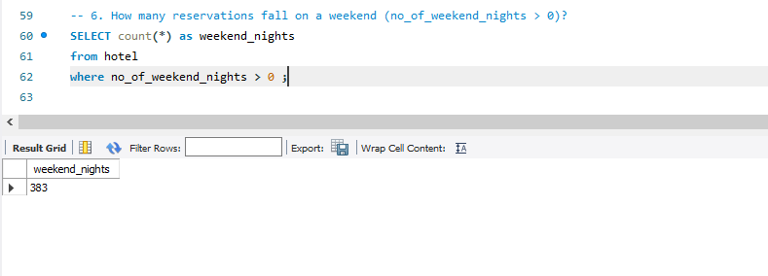
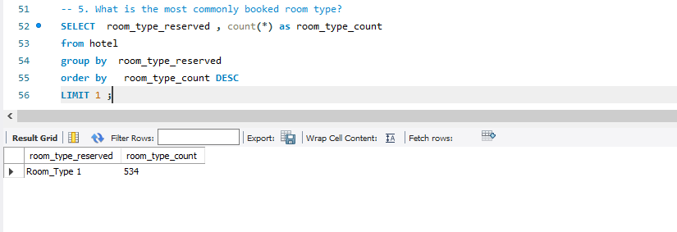
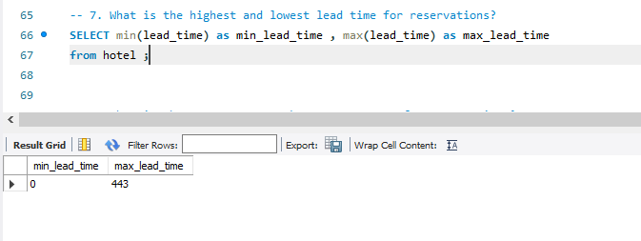
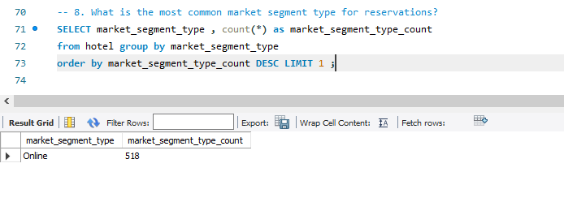
Project 01
63 %
63 %
63 %
63 %
Retour à l'ordre du jour
TAZI Mohannad
09

Slide 10
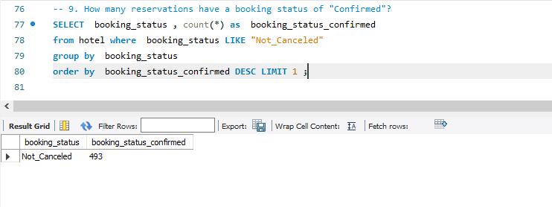
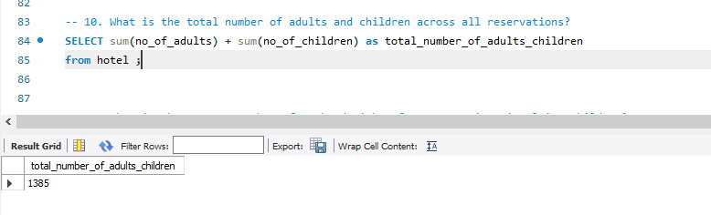
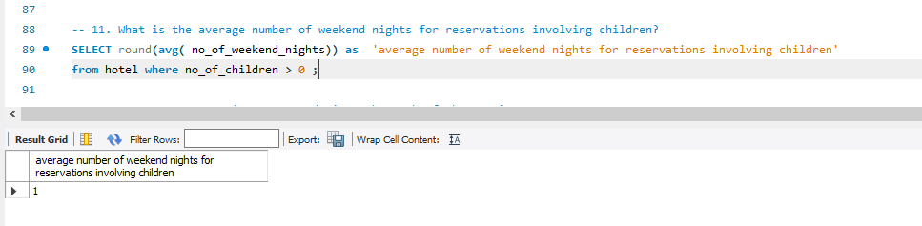
Project 01
63 %
63 %
63 %
Retour à l'ordre du jour
TAZI Mohannad
10

Slide 11
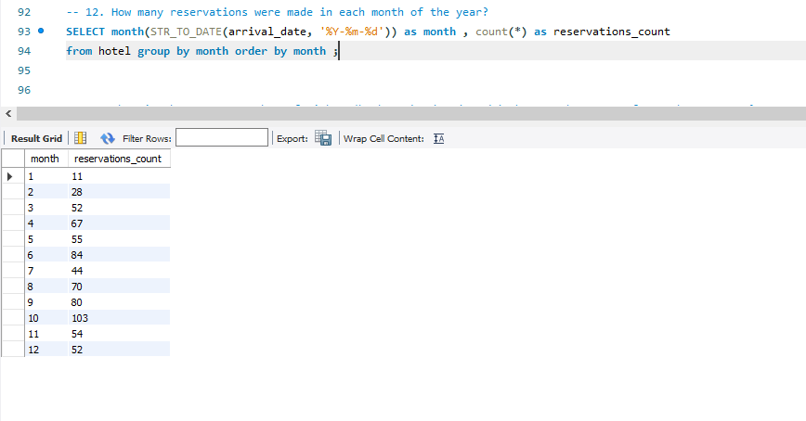
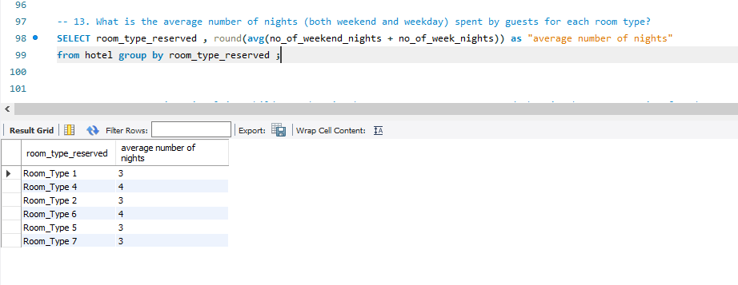
Project 01
63 %
63 %
63 %
TAZI Mohannad
11

Slide 12
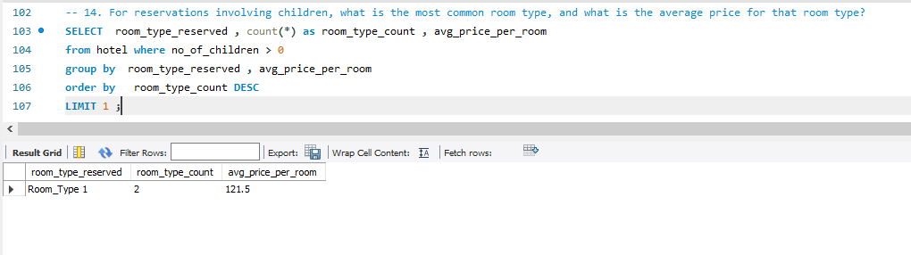
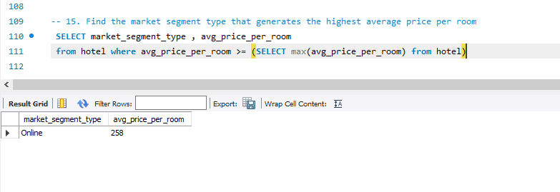
Project 01
63 %
63 %
Retour à l'ordre du jour
TAZI Mohannad
12

Slide 13

Project 01
Insights from the analysis of 700 reservations:
Meal plan 1 emerges as the most popular choice, selected 527 times in the dataset.
The average price per room for reservations involving children is $144.57.
Room type 1 is the predominant choice for bookings.
A significant portion, 383 out of 700 reservations, fall on weekends.
Lead times range from 0 to 443, indicating varied booking patterns.
The most common market segment for reservations is Online, constituting 518 bookings.
Out of the total reservations, 493 are confirmed.
The combined count of adults and children across reservations is 1385.
On average, reservations involving children during weekends amount to 1 per booking.
October registers the highest number of reservations, while January sees the lowest.
Room type 1 is the most prevalent choice for reservations involving children, with an average price of $121.5.
Reservations made through the Online market segment generate the highest average price per room.
TAZI Mohannad
13

